Slide 1

ON-LINE ANALYTICAL PROCESSING
Dr. Yashvardhan Sharma
Department of Computer Science & Information Systems
BITS, Pilani
L10 (Lec 17)

Slide 2
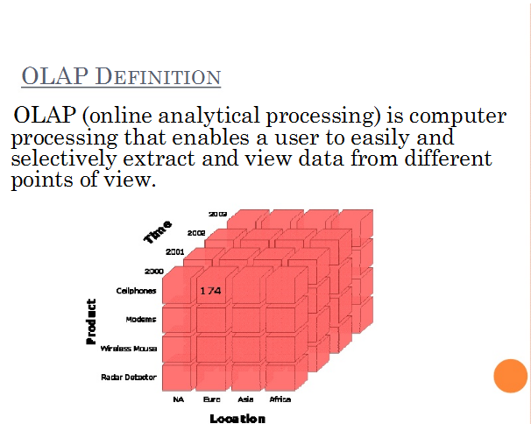

Slide 3
Typical calculations in the query requests
Roll-ups to provide summaries and aggregations along the hierarchies of the dimensions
Drill-downs from the top level to the lowest along the hierarchies of the dimensions, in combinations among the dimensions
Simple calculations, such as computation of margins
Share calculations to compute the percentage of parts to the whole
Algebraic equations involving key performance indicators
Moving averages and growth percentages
Trend analysis using statistical methods

Slide 4
OLTP vs Data warehouse
Characteristic
Analytical capabilities
Data for a single session
Size of result set
Response time
Data granularity
Data currency
Access method
Basic motivation
Data model
Optimization of database
Update frequency
Scope of user interaction
OLTP Systems
Very low
Very limited
Small
Very fast
Detail
Current
Predefined
Collect and input data
Design for data updates
For transactions
Very frequent
Single transactions
Data Warehouse
Moderate
Small to medium size
Large
Fast to moderate
Detail and summary
Current and historical
Predefined and ad hoc
Provide information
Design for queries
For analysis
Generally read-only
Throughout data content

Slide 5
Limitations of other analysis methods
No support for multidimensionality
Inability to drill down to lower levels in the dimensions
No support to rotate result by switching rows and columns
Inability of SQL fetch results for complex calculations and handling time series data
No alteration of the presentation of the result data sets possible

Slide 6
OLAP Advantages
It can reorganize metrics along several dimensions and allow data to be viewed from different perspectives
Supports multidimensional analysis
Ability to roll up , drill down within each dimension
Fast response
Can be implemented on web
Highly interactive analysis

Slide 7
Simple OLAP Session

Slide 8
Demand for OLAP
Traditional tools of report writers, query products, spreadsheets, & language interfaces do not match the user expectations as far as performing multidimensional analysis with complex calculations is concerned.
Tools used with OLTP and basic DW environments do not match up to the task

Slide 9
OLAP is the Answer!
OLAP is a category of software technology that enables analysts, managers, and executives to gain insight into the data through fast, consistent, interactive, access in a wide variety of possible views of information that has been transformed from raw data to reflect the real dimensionality of the enterprise as understood by the user.

Slide 10
What is OLAP?
OLAP software provides the ability to analyze large volumes of information to improve decision making at all levels of an organization.

Slide 11
What is OLAP?
A wide spectrum of multidimensional analysis involving intricate calculations and requiring fast response times.

Slide 12
What is OLAP?
OLAP has two immediate consequences: online part requires the answers of queries to be fast, the analytical part is a hint that the queries itself are complex
i.e., Complex questions with Fast Answers!

Slide 13
Why a separate OLAP tool?
Empowers end users to do own analysis
Frees up IS backlog of report requests
Ease of use
No knowledge of tables or SQL required

Slide 14
OLAP Characteristics
Multi-user environment
Client-server architecture
Rapid response to queries, regardless of DB size and complexity

Slide 15
Guidelines for an OLAP System
Multidimensional Conceptual View: It conforms to how the users perceive business problems
Transparency: It helps to enhance the efficiency and productivity of the users through transparent technology, underlying data repository, computing architecture, and the diverse nature of source data
Accessibility: Provide access only to the data that is actually needed to perform the specific analysis, presenting a single, coherent, and consistent view to the users
Consistent Reporting Performance: Provide consistent run time, response time, or machine utilization
Client/Server Architecture: It provides optimum performance, flexibility, adaptability, and interoperability
Generic dimensionality: one logical structure for all dimensions

Slide 16
Guidelines for an OLAP System
Dynamic Sparse Matrix Handling: The system must be able to dynamically deduce the distribution of the data and adjust the storage and access to achieve and maintain consistent level of performance
Multiuser Support
Unrestricted Cross Dimensional Operations: Provide ability for the system to recognize dimensional hierarchies and automatically perform roll-up and drill-down operations within a dimension or across dimensions
Intuitive Data Manipulation
Flexible reporting: Every dimension, including any subsets, must be able to be displayed with equal ease
Unlimited Dimensions and Aggregation Levels

Slide 17
Data Warehouse & OLAP
OLAP is a software system that works on top of a DW
A front-end tool for a DW
Information delivery system for the DW
Compliments the information delivery capacities of a DW

Slide 18
Why is OLAP useful?
Facilitates multidimensional data analysis by pre-computing aggregates across many sets of dimensions
Provides for:
Greater speed and responsiveness
Improved user interactivity

Slide 19
OLAP Functionalities
OLAP software provides some or all of the following functionalities:
Drilling down from high-level summaries to better understand data relationships.
Viewing data from different perspectives, called pivoting or rotation
Comparisons among different elements
Exception reports to highlight unusual situations· Time-series analysis to identify trends
Forecasting with a variety of quantitative techniques
Running model-based what-if simulations to understand the interactions among the different parts of the business

Slide 20
Concept Hierarchies
A Concept Hierarchy defines a sequence of mappings from a set of low-level concepts to high-level
Consider a concept hierarchy for the dimension “Location”

Slide 21
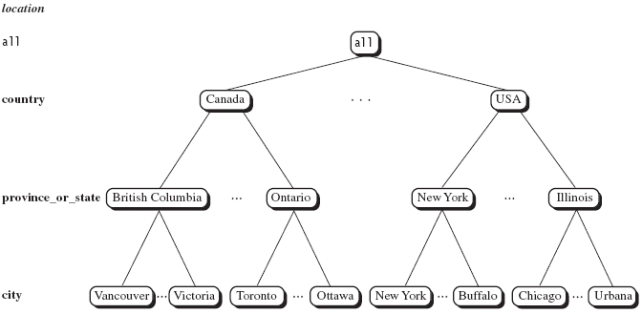
Concept Hierarchies

Slide 22
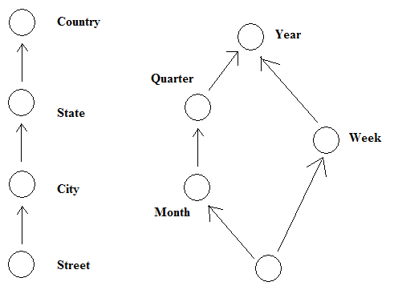
Concept Hierarchies
Many concept hierarchies are implicit within the database system

Slide 23
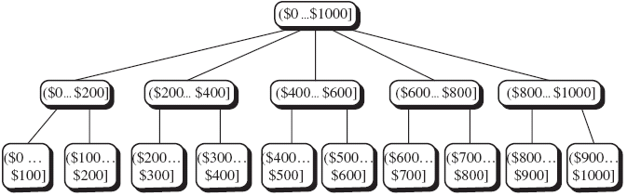
Concept Hierarchies
Concept hierarchies may also be defined by grouping values for a given dimension or attribute, resulting in a set-grouping hierarchy

Slide 24
Dimensional Analysis

Slide 26
Hypercubes

Slide 28
In the figure, note the three straight lines, two of which represent the two business dimensions and the third, the metrics. You can independently move up or down along the straight lines.
Some experts refer to this representation of a multidimension as a multidimensional domain structure (MDS).

Slide 33
Drill down: It refers to the process of viewing data at a level of increased detail
Roll up: It refers to the process of viewing data with decreasing detail

Slide 34
Example of roll-up

Slide 35
Rollup & Drill-down
OLAP permit users to view data at ay desired level of granularity.
Rollup: moving from finer-granularity data to coarser granularity
Drill-down: opposite to Rollup

Slide 36
Slice-and-Dice or Rotation
Slice n dice: It is an ability to move between different combinations of dimensions when viewing data with an OLAP browser

Slide 37
Slicing & Dicing
Additional Functionality that can be thought of as viewing a slice of the data cube, particularly when values for multiple dimensions are fixed.
Slicing/Dicing simply consists of selecting specific values for these attributes, which are then displayed on top of the cross-tab

Slide 38
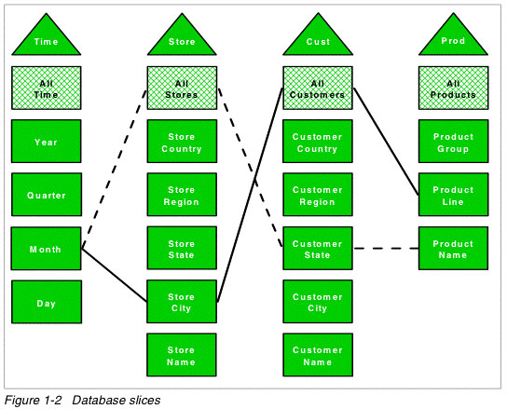

Slide 39
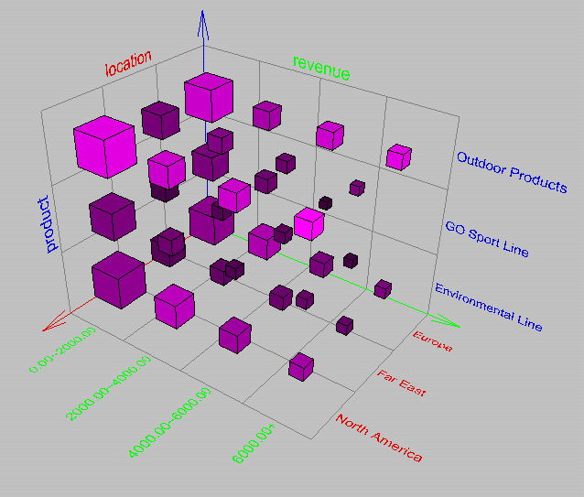
Browsing a Data Cube

Slide 40
OLAP Operation
So, how are concept hierarchies useful in OLAP?
In the multidimensional model, data are organized into multiple dimensions,
And each dimension contains multiple levels of abstraction defined by concept hierarchies

Slide 41
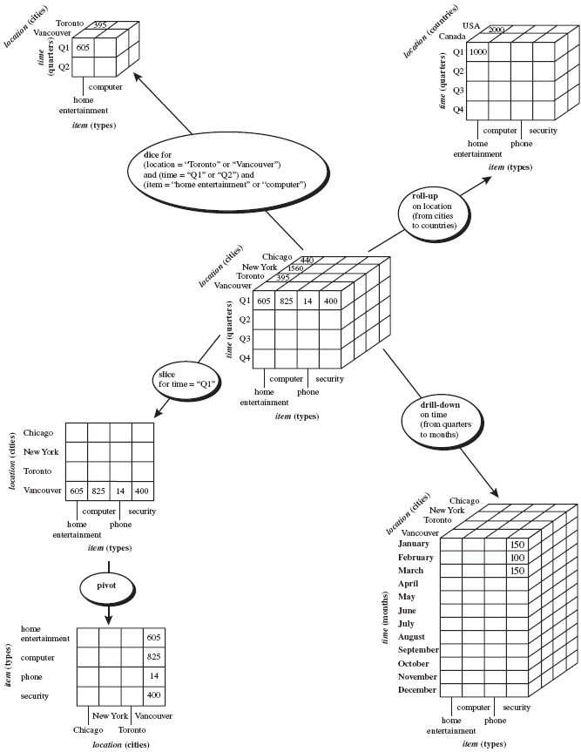

Slide 42
Typical OLAP Operations
Roll up (drill-up): summarize data
by climbing up hierarchy or by dimension reduction
Drill down (roll down): reverse of roll-up
from higher level summary to lower level summary or detailed data, or introducing new dimensions

Slide 43
Typical OLAP Operations
Slice and dice: project and select
Pivot (rotate):
reorient the cube, visualization, 3D to series of 2D planes

Slide 44
Multidimensional Data
Sales Volume as a function of time, city and product
NY
LA
SF
Juice
Cola
Milk
Cream
10
47
30
12
3/1 3/2 3/3 3/4
Date

Slide 45
Operations in Multidimensional Data Model
Aggregation (roll-up)
dimension reduction: e.g., total sales by city
summarization over aggregate hierarchy: e.g., total sales by city and year -> total sales by region and by year
Selection (slice) defines a subcube
e.g., sales where city = Palo Alto and date = 1/15/96
Navigation to detailed data (drill-down)
e.g., (sales - expense) by city, top 3% of cities by average income
Visualization Operations (e.g., Pivot)

Slide 46
A Visual Operation: Pivot (Rotate)
NY
LA
SF
Month
Juice
Cola
Milk
Cream
10
Region
47
30
12
Product
3/1 3/2 3/3 3/4
Date

Slide 47
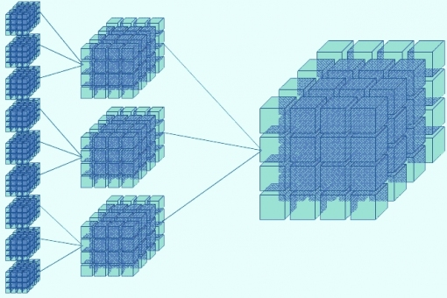
Roll-up: (Aggregate, Consolidate) A roll-up involves computing all of the data relationships for one or more dimensions. To do this, a computational relationship or formula might be defined.

Slide 48
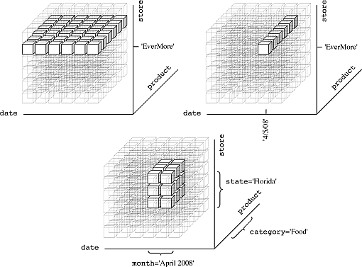
Drill Down: Drilling down is a specific analytical technique whereby the user navigates among levels of data ranging from the most summarized (up) to the most detailed (down).

Slide 49
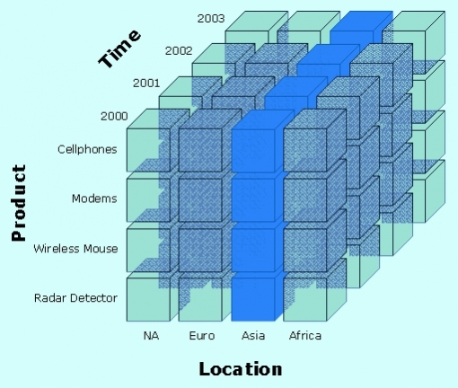
Slice: A slice is a subset of a multi-dimensional array corresponding to a single value for one or more members of the dimensions not in the subset.

Slide 50
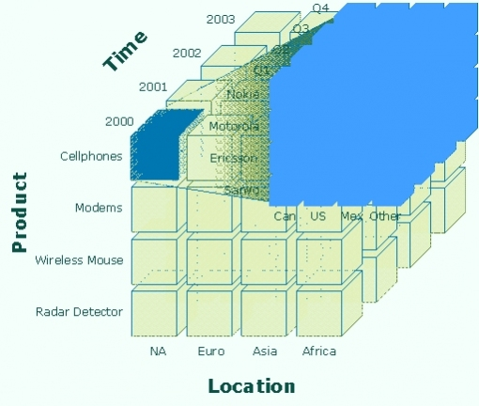
Dice: The dice operation is a slice on more than two dimensions of a data cube (or more than two consecutive slices).

Slide 51
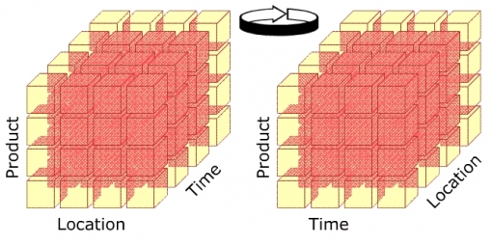
Pivot:This operation is also called rotate operation. It rotates the data in order to provide an alternative presentation of data – the report or page display takes a different dimensional orientation.

Slide 52
Uses and Benefits
Increased productivity of business managers, analysts, and executives
Faster delivery of applications by IT people
Self sufficiency of users, resulting in reduction in backlog
More efficient operation through reducing time on query executions and in net work traffic
Ability to model real world challenges with business metrics and dimensions

